Slide 1


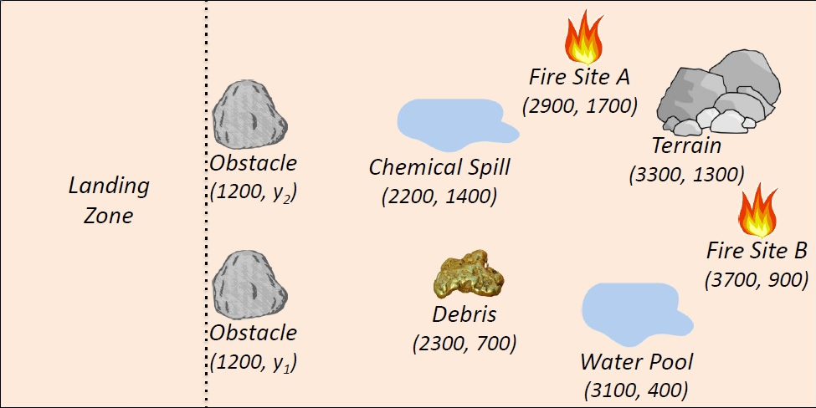
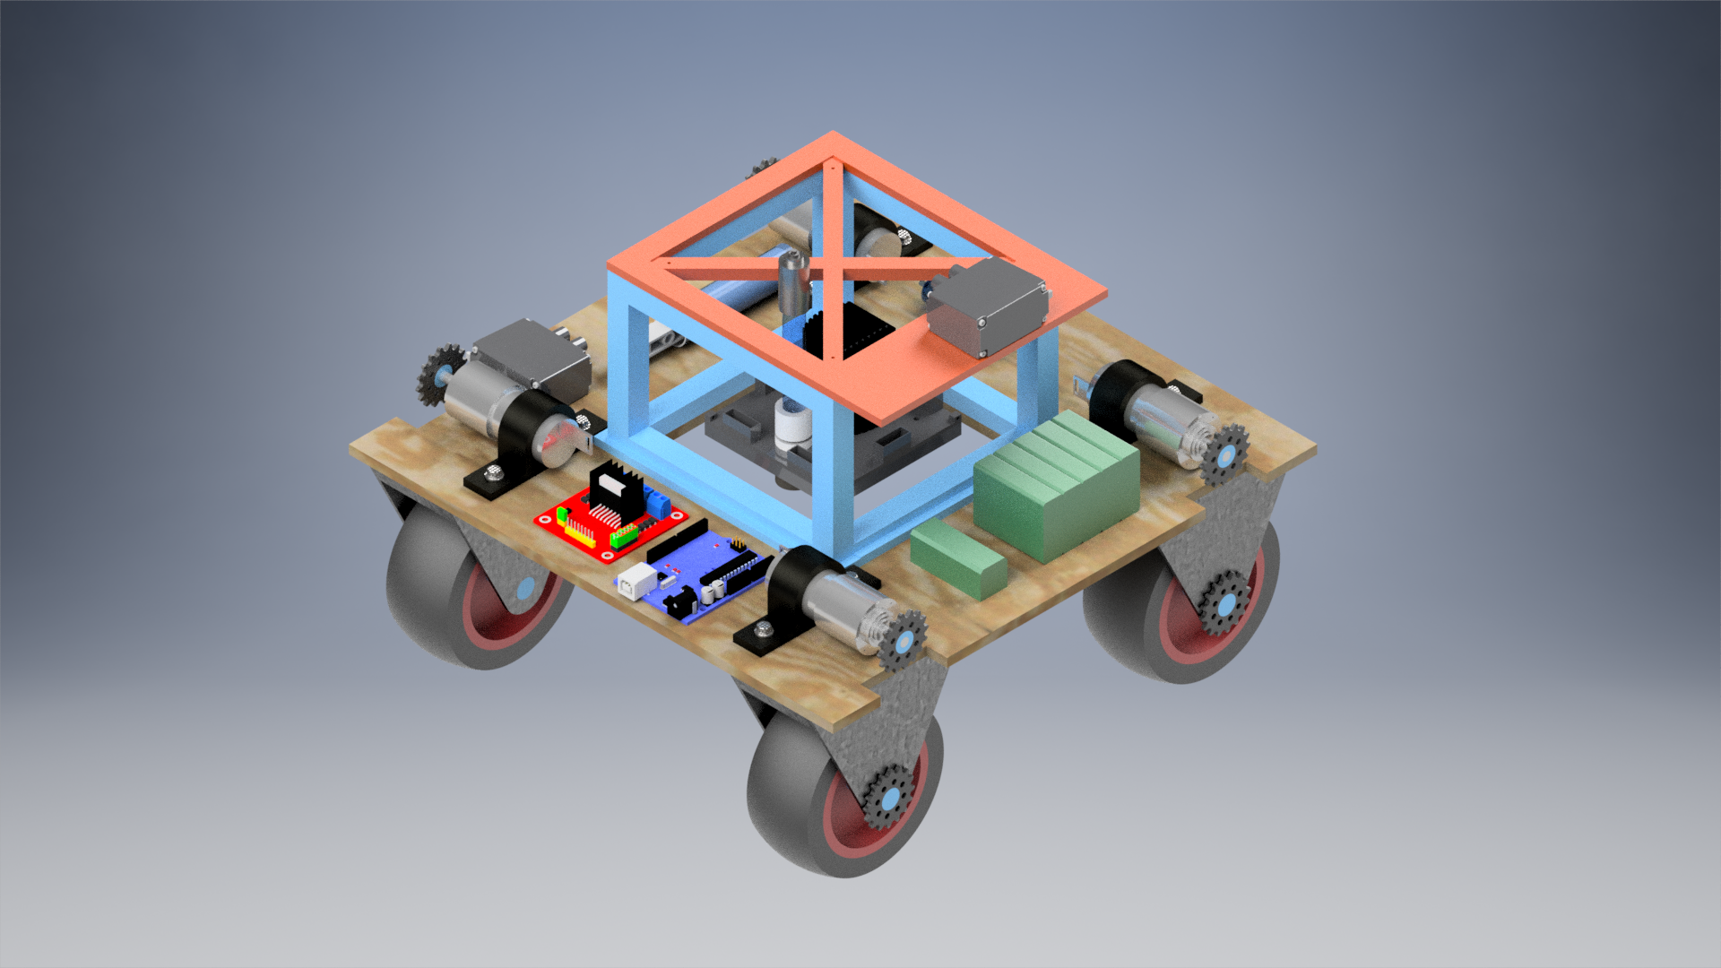
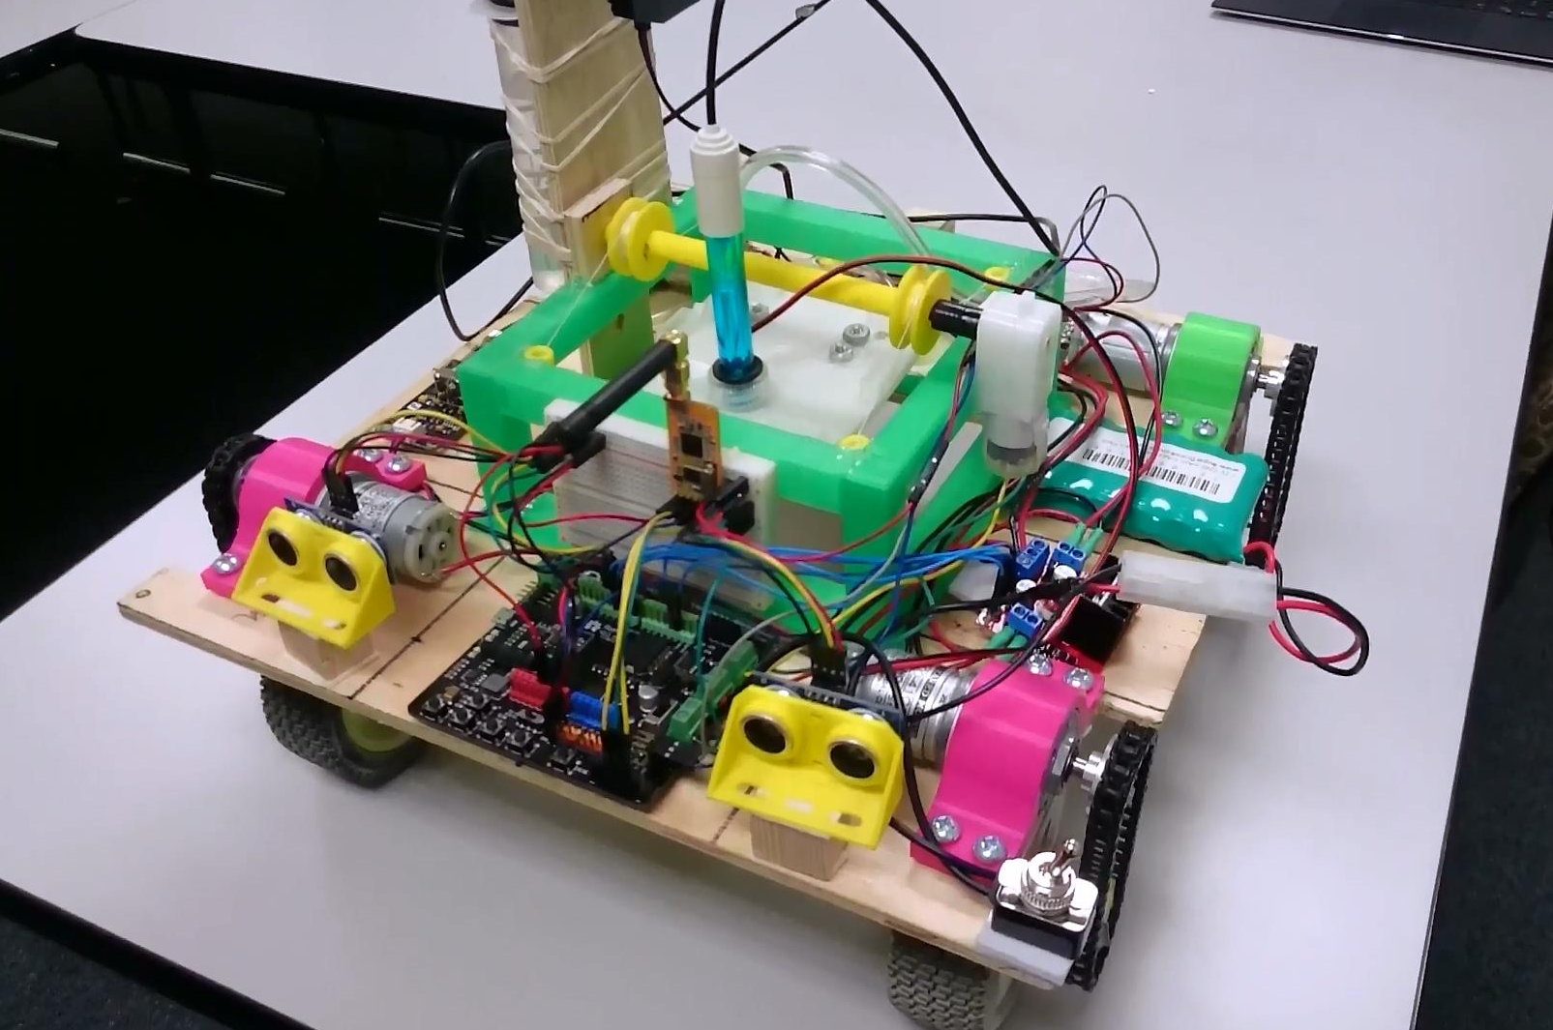
Team STS
Sulfur Tungsten Silver
Isaac Lee | Kenneth Daniel | John Murdock | Michael Tao | Spencer Mical | Eliav Winton | Stephen Waak
ENES 100 – 0601 | Evandro Valente | Spring 2016
Mission
Design
Design and build an autonomous vehicle which can:
Navigate to the mission site within 250mm
Measure and transmit the pH of a pool of water within .3 pH
Advanced Objectives:
Collect a 10-15mL sample of the polluted water
Neutralize the pool to within 6-8pH
The OSV is designed to accomplish all objectives and it functions around a platform based delivery system. At the middle of the OSV, there is a cutout where a platform with instruments lowers into the pool. The major design implications include:
Locomotion:
Uses a chain and sprocket system to drive wheels with motors above (so OSV can drive over pool)
Mission:
The OSV navigates to the pool and centers itself above it
A platform with the pH meter, submersible pump, and tubes lowers into the pool
pH meter takes a reading and transmits it, completing all base objectives
A solenoid triggers, releasing a tensioned syringe which draws a sample from the tube
To neutralize, a motor pulls off a stopper from a syringe full of basic solution, which dispenses through the tube
Simultaneously, the submersible pump mixes the pool
The Arena
Initial CAD
Design process
Final Product
Preliminary systems design without advanced objective capability
Adapted to physical limitations of components:
Created a mechanism to securely attach the sprockets to the axles
Consolidated power system to make room for components
Added relay switches to activate system mechanisms
Redesigned layout to accommodate test results:
Changed how base solution is dispensed after determining accuracy was irrelevant
Shortened tubes to help drain base solution
Completed functioning OSV with all components and objective capability
Diagram
Performance
# | Part Description
1 | Lifting platform
2 | pH Meter
3 | Stopper pull motor
4 | Solenoid
5 | Sampling syringe
6 | Base syringe
7 | Platform motor
8 | Ultrasonic sensor
9 | Wheel
10 | Drive motor
11 | Sprocket
12 | Microcontroller
13 | H-Bridge
14 | 7.2V NiMH battery
The OSV was the highest scoring OSV for chemical in Spring 2016 with a cumulative score of 135.
Scoring run 1:
Accomplished both base objectives
Scoring run 2:
Accomplished both base objectives
Neutralized the pool
Drew a 9mL sample (1mL away from goal)
Lessons learned
The platform design allowed for easy completion of mission objectives, but introduced difficulties for locomotion. Custom parts had to be designed and hand built to accommodate the increased complexity, and only at the end did we have the OSV moving reliably. Main takeaways are:
Do not make what can be simple, complicated
Consider all implications when choosing a design
Ensure basic functionality before focusing on more advanced features

